Slide 1
Team Rapid Coders

Slide 2

Telehealth Solutions:
Within and beyond the pandemic situation

Slide 3
The problem
To deliver healthcare services to people during the troubled times of a pandemic such that there is minimal physical contact between the people.

Slide 4

The solution
We made a website which will help people get fast access to doctors and hospital services during the pandemic.
People can use the website for consulting with doctor in their cit via video call and chat. The doctors can keep log of patient vitals.Users can also use it to see number of infected people in the

Slide 5
The team
Shivam Chahar
Vasu Mandhanya
Siddharth Dinkar
Backend Developer
Backend Developer
Frontend Developer

Slide 6
Key Features:
To give users information based on their city and state.
Along with that their is the site also provides the user with various guidelines from WHO.
The website shows the user all the hospitals in their city and state. Along with that the users can also see all the doctors affiliated with a particular hospital.
They can consult with any doctor of their choice and the doctor can monitor their vitals.
The user can consult with the doctors via video call or chat option provided on the site itself.
The user can also see the bed availability in various hospitals across the country.
Along with the users, the site can also be helpful to the hospital administration, they can keep track of all the covid patients by the simple upload of a csv file.

Slide 7
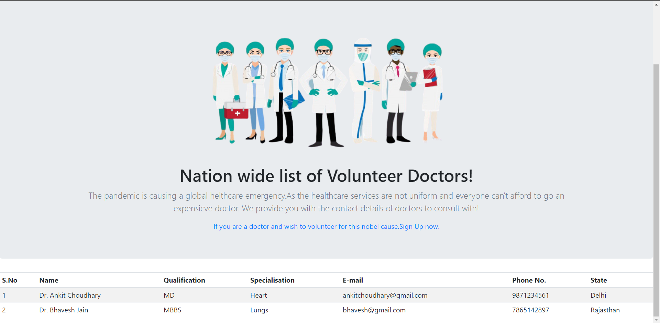
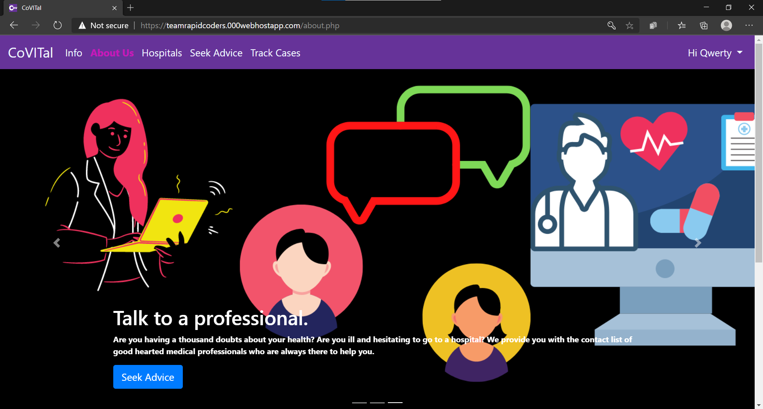

Slide 8
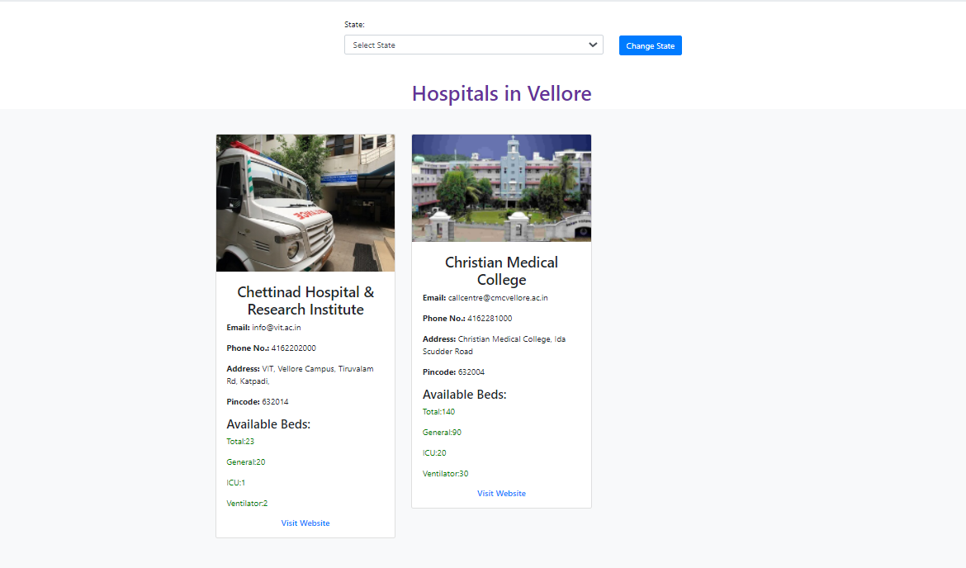

Slide 9
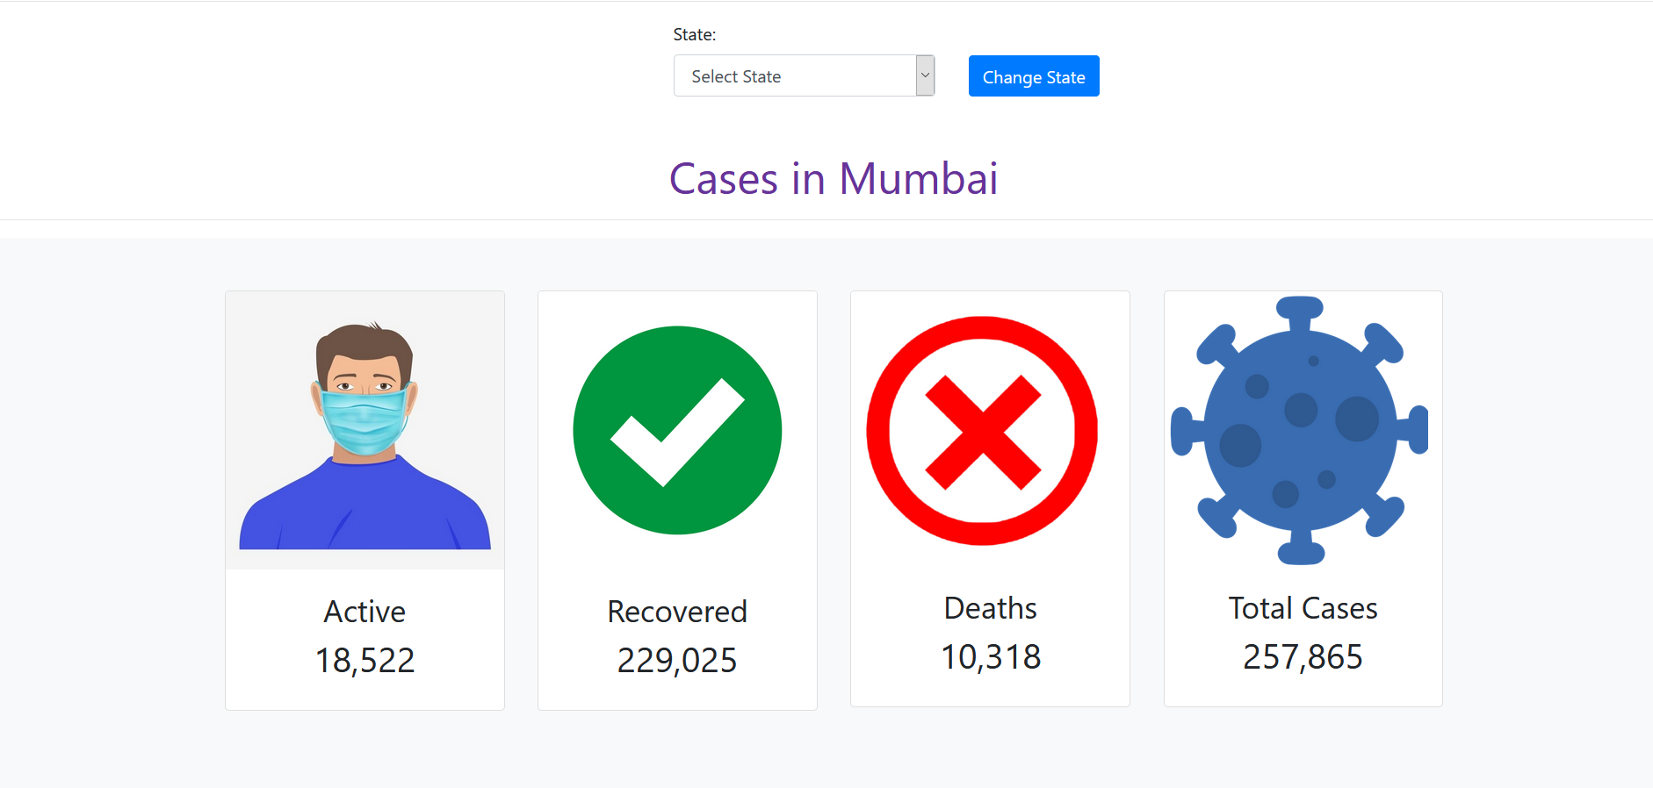

Slide 10
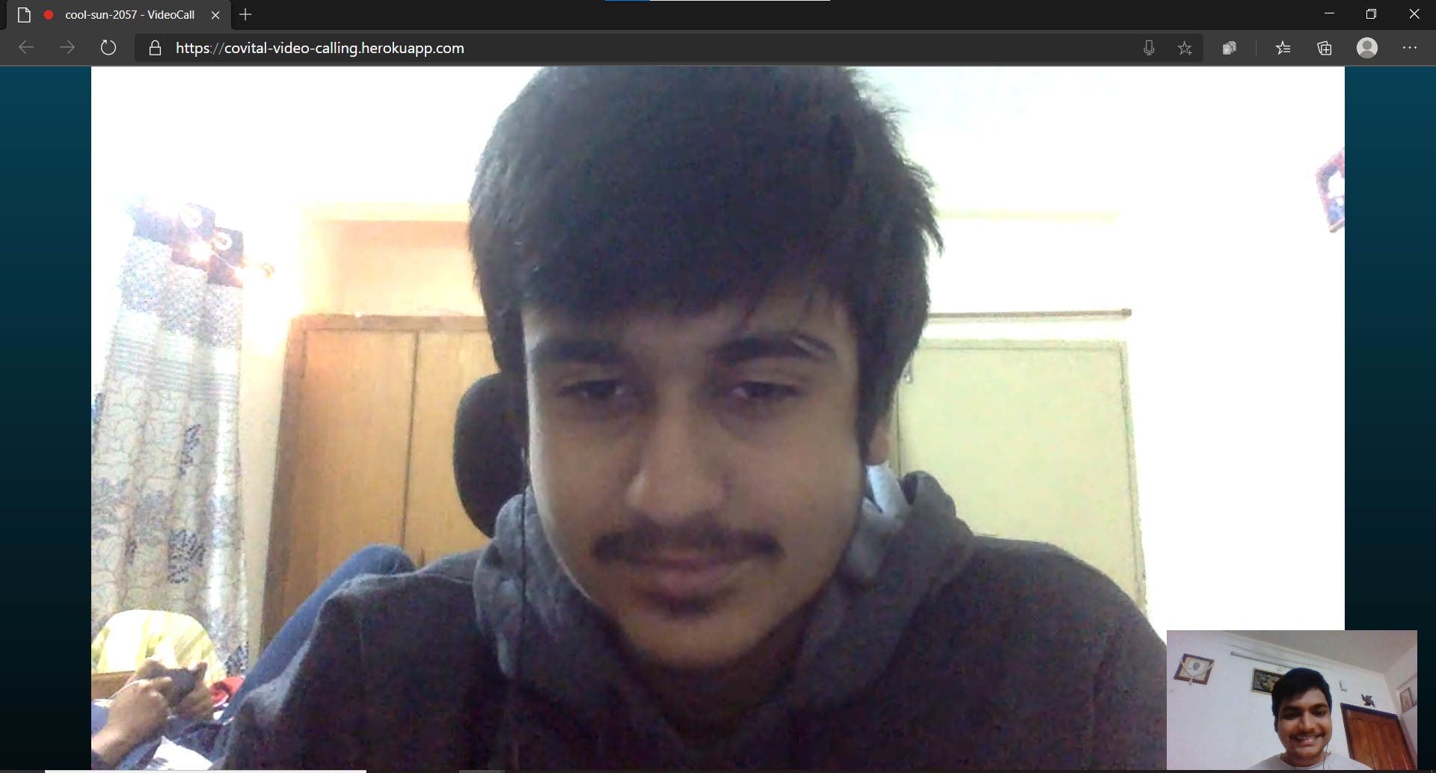

Slide 11
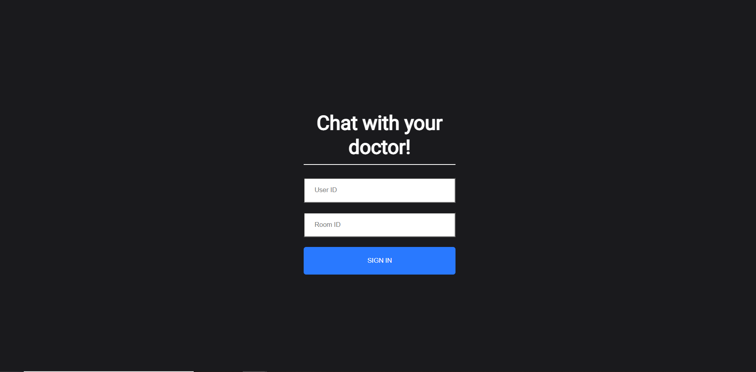

Slide 12
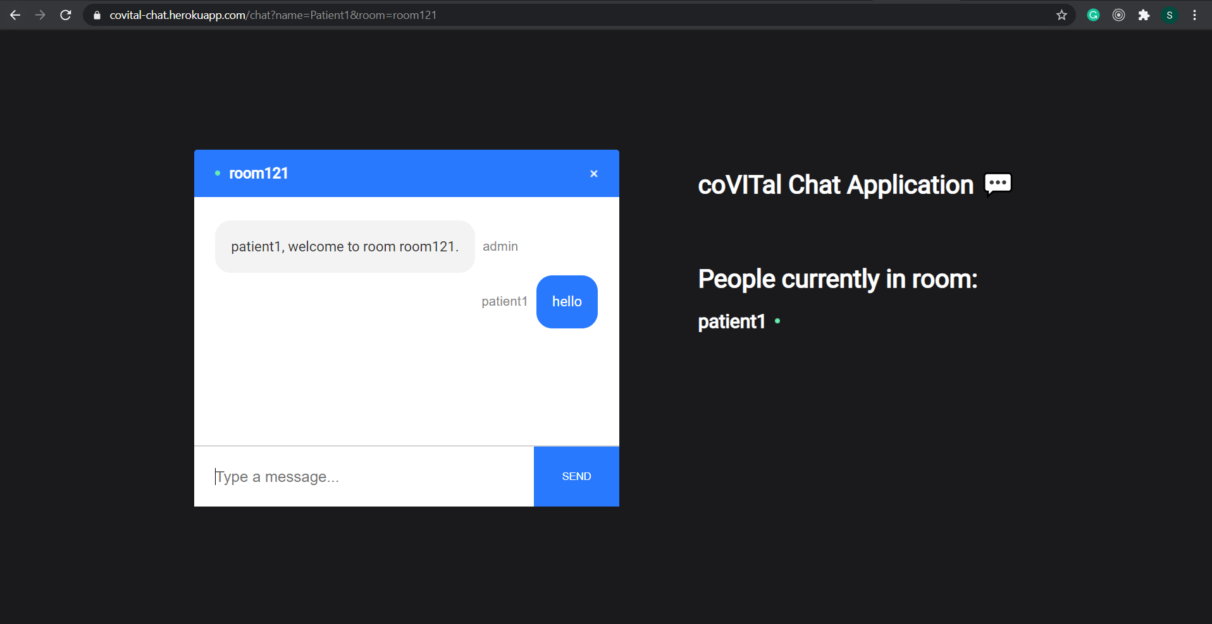

Slide 13
Check out our Website at
https://teamrapidcoders.000webhostapp.com/

